Slide 1

Course Name:
COMPILER DESIGN LAB
Course code:
SCSA2602

Slide 2
Course Outcome
Apply the LEX tool & YACC tool to develop a scanner & parser.
Demonstrate the process of lexical analysis, parsing and other compiler design aspects.
Examine practical programming skills necessary for constructing a compiler.
Construct Automata for any regular language.
Generate symbol table and target code.
Design a simple compiler.

Slide 3
List of Experiments
Study of LEX and YACC Tools.
Use LEX tool to implement Lexical Analyzer.
Use LEX and YACC to implement Parser.(Using Ambiguous and Unambiguous Grammar)
Use LEX and YACC tool to implement Desktop Calculator.
Construction of NFA and DFA from a regular expression.
Implement Recursive Descent Parser algorithm.
Implement Shift Reduce Parser algorithm.
Implement Operator Precedence Parser algorithm.
Implement the backend of the compiler.
Implement Symbol Table Management.
Construct a Simple compiler.

Slide 4
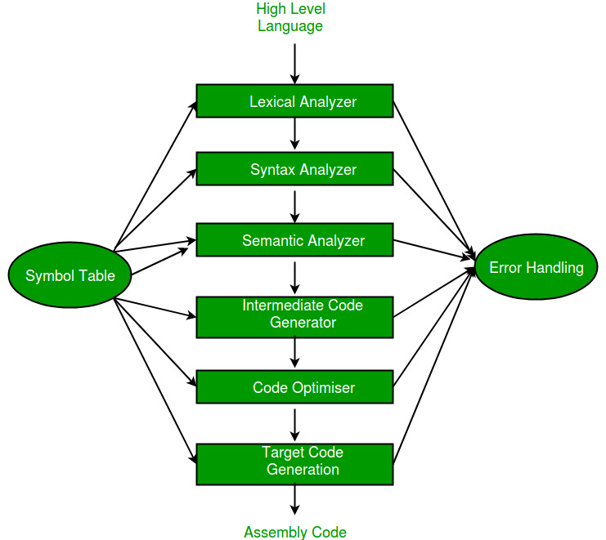
PHASES OF A COMPILER

Slide 5
Flex (Fast Lexical Analyzer Generator )
A tool/computer program for generating lexical analyzers (scanners or lexers) written by Vern Paxson in C around 1987.
It is used together with Berkeley Yacc parser generator or GNU Bison parser generator.
Flex and Bison both are more flexible than Lex and Yacc and produces faster code.
YACC-Yet Another Compiler Compiler

Slide 6
LEX-LEXICAL ANALYZER GENERATOR
Lex is a lexical analyzer tool mostly used with yacc parse generator.
Tool for recognizing tokens in a program.
Tokens are the terminals of a language,
English:
words, punctuation marks, …
Programming language:
Identifiers, operators, keywords, …
Regular expressions define terminals/tokens.
It lexically analyses (i.e. matches) the patterns (regular expressions) given as input string or as a file.

Slide 7
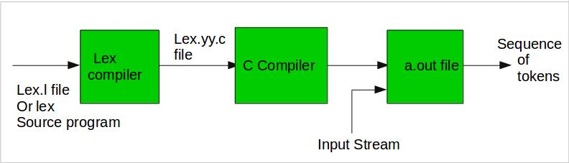
Processing a LEX program
Step 1: An input file describes the lexical analyzer to be generated named lex.l is written in lex language. The lex compiler transforms lex.l to C program, in a file that is always named lex.yy.c.
Step 2: The C complier compile lex.yy.c file into an executable file called a.out.
Step 3: The output file a.out take a stream of input characters and produce a stream of tokens.

Slide 8
Structure of LEX Program
The lex program consists of three sections, separated by a line with just %% ;
definitions section
%%
rules section
%%
auxiliary function/user code section

Slide 9
Lex predefined functions and variables
yyin | the input stream pointer.
yytext | a buffer that holds the input characters that actually match the pattern (i.e lexeme).
yyleng | the length of the lexeme .
yylval | contains the token value .
yyout | the output stream pointer.
yylex() | The main entry point for lex, reads the input stream generates tokens, returns zero at the end of input stream.
yywrap() | Called by lex when input is exhausted (or at EOF). default yywrap always return 1.
yymore() | returns the next token .
yyless(k) | returns the first k characters in yytext .

Slide 10
Definition Section
generally used to declare functions, include header files, or define global variables and constants .
text is enclosed in %{ … %} brackets. Anything written in this brackets is copied directly to the file lex.yy.c
eg.:
%{
#include<stdio.h>
int global_variable;
% }
Regular definitions, has of the form,
name definition
e.g.:
digit [0-9]
letter [a-zA-Z]

Slide 11
Rules Section
Each rule has the form
pattern action
where:
pattern describes a pattern to be matched on the input.
action must begin on the same line.
If action is empty, the matched token is discarded.
eg.:
%%
{digit}+ {printf(“ number”);}
{letter}* {printf(“ name”);
%%

Slide 12
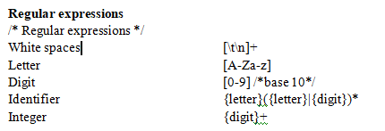
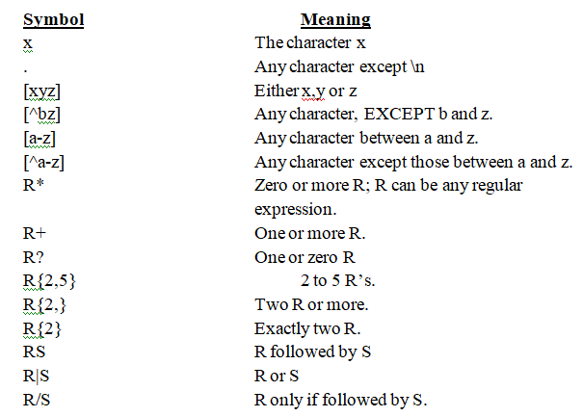
How to write rules

Slide 13
Auxiliary Functions
LEX generates C code for the rules specified in the Rules section and places this code into a single function called yylex().
/* Declarations */
%%
/* Rules */
%%
int main()
{
yylex();
return 1;
}
This section contain C statements and additional functions.

Slide 14
Executing a Lex Program
Lex source program
Lex
lex.yy.c
lex.yy.c
C compiler
a.out
Input file
a.out
Stream of tokens

Slide 15
How to run the program
run the program, it should be first saved with the extension .l or .lex.
Step 1: lex filename.l or lex filename.lex
Step 2: gcc lex.yy.c
Step 3: ./a.out
Step 4: Provide the input to program in case it is required
https://flex-windows-lex-and-yacc.software.informer.com/

Slide 16
FLEX FOR WINDOWS
WELCOME TO INSTALLATION AND WORKING ENVIRONMENT

Slide 17
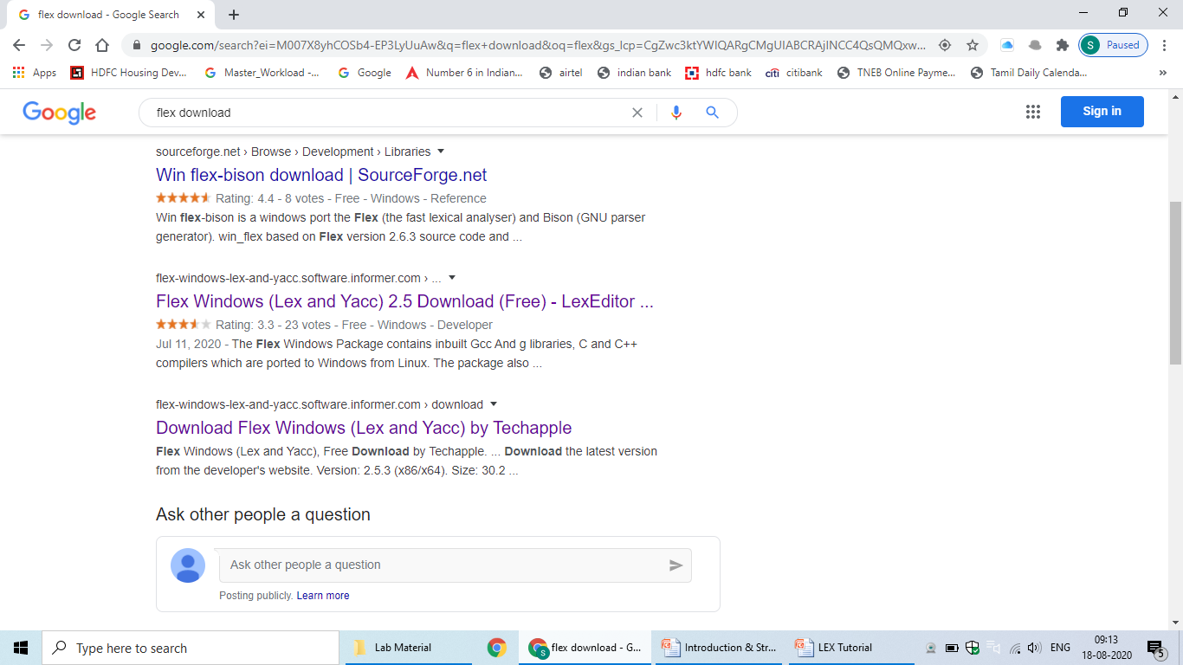

Slide 18
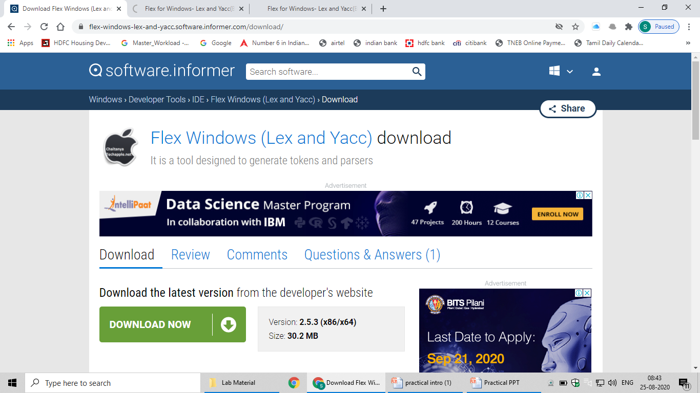

Slide 19
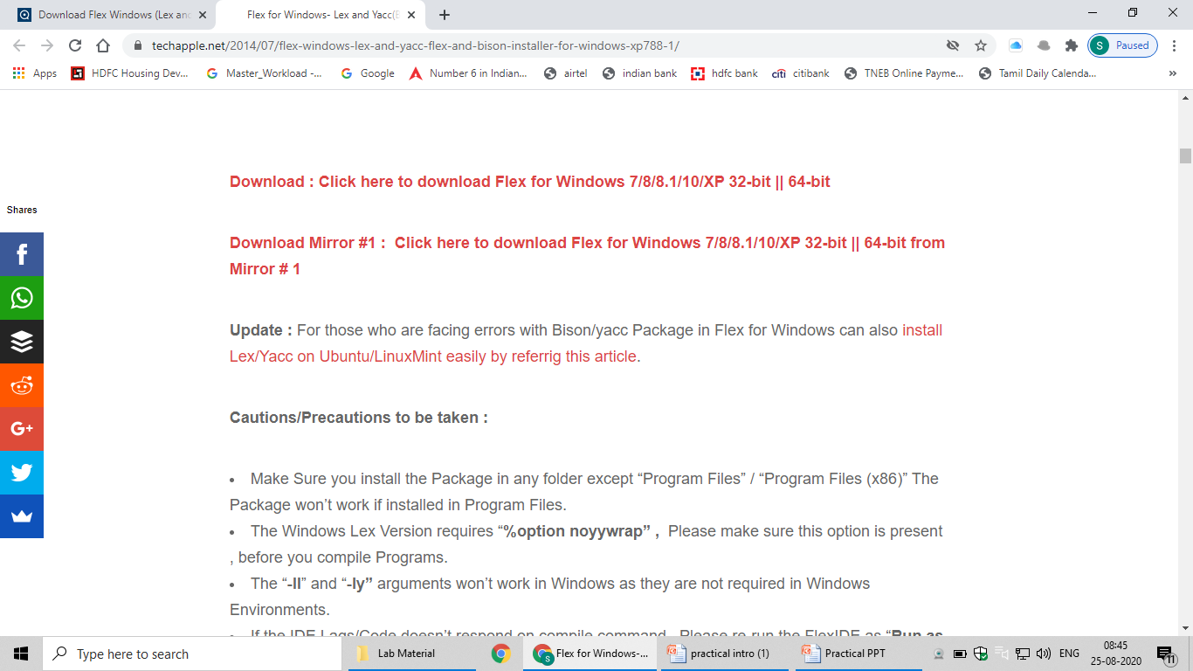

Slide 20
ALTERNATE INSTALLATION

Slide 21
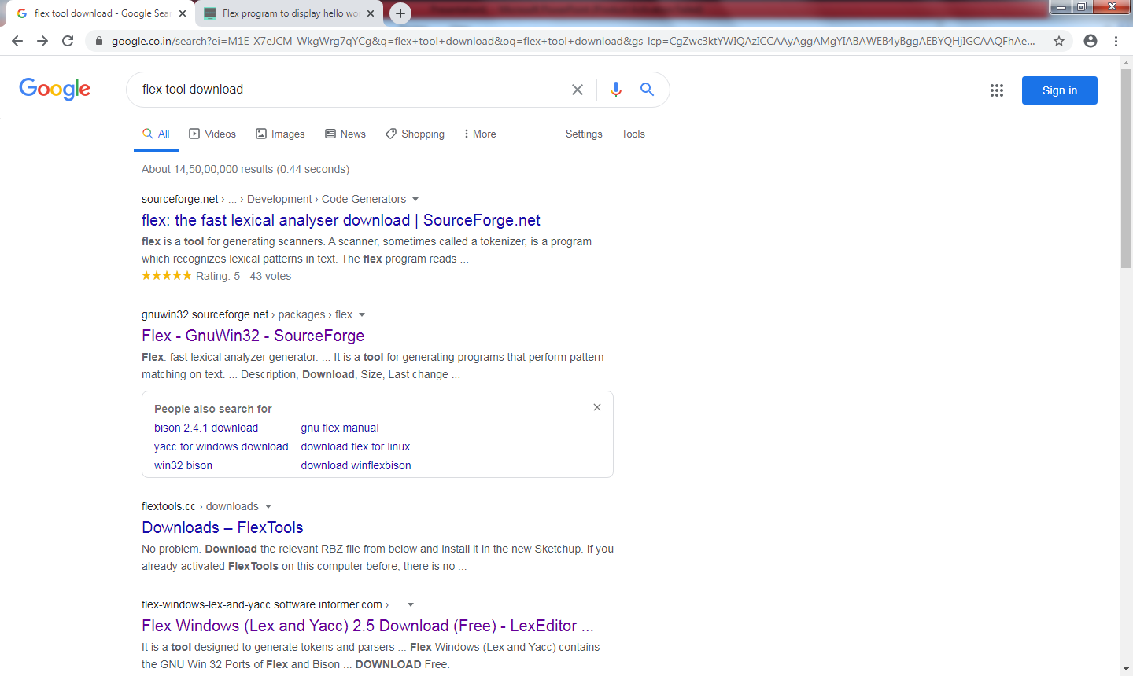

Slide 22
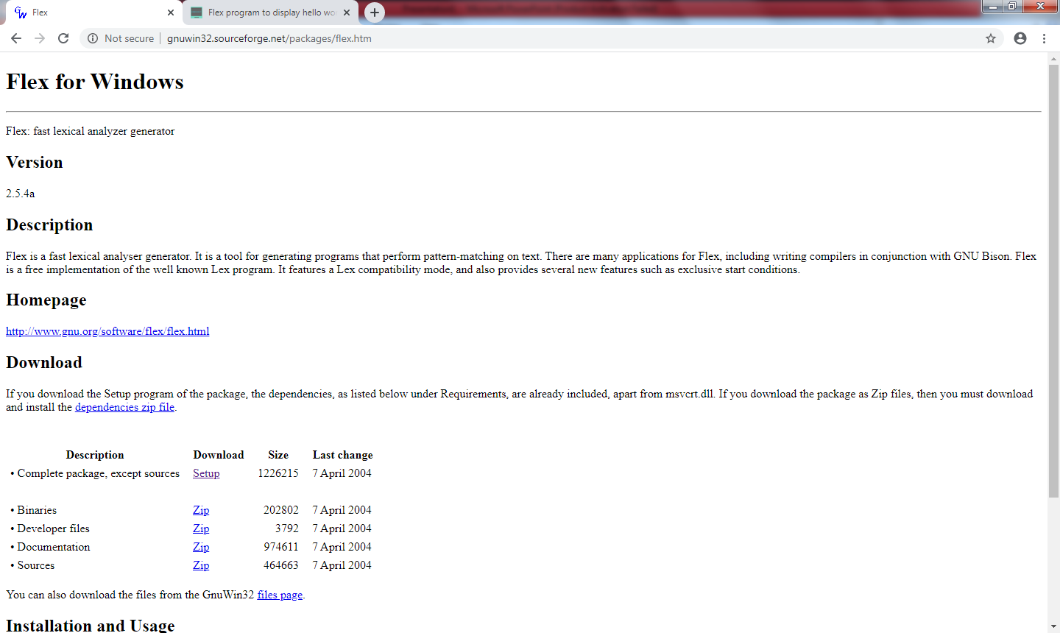

Slide 23
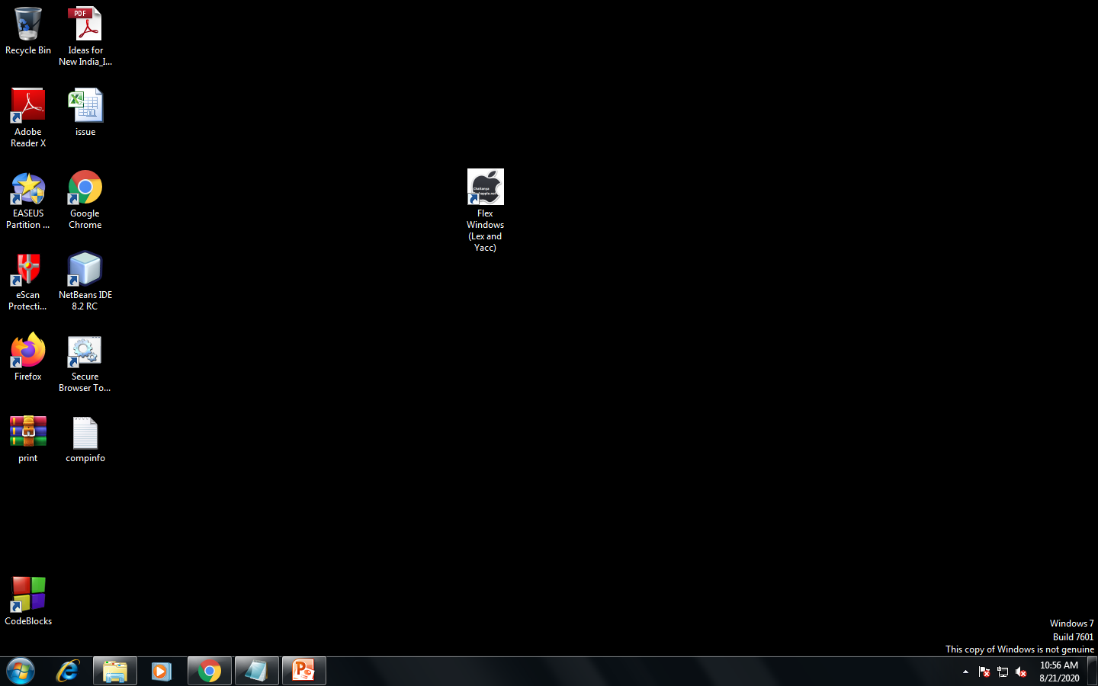

Slide 24
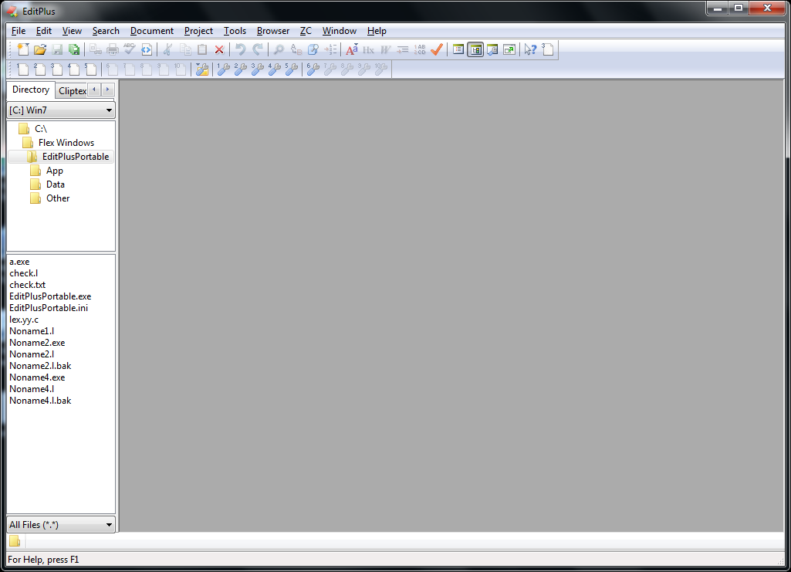

Slide 25
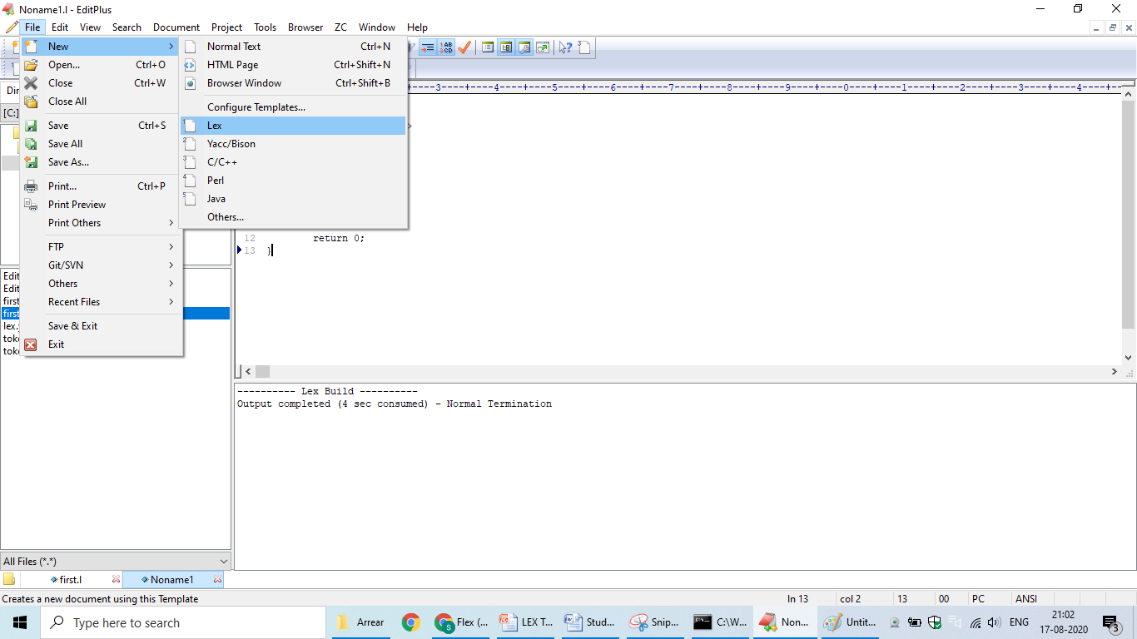

Slide 26
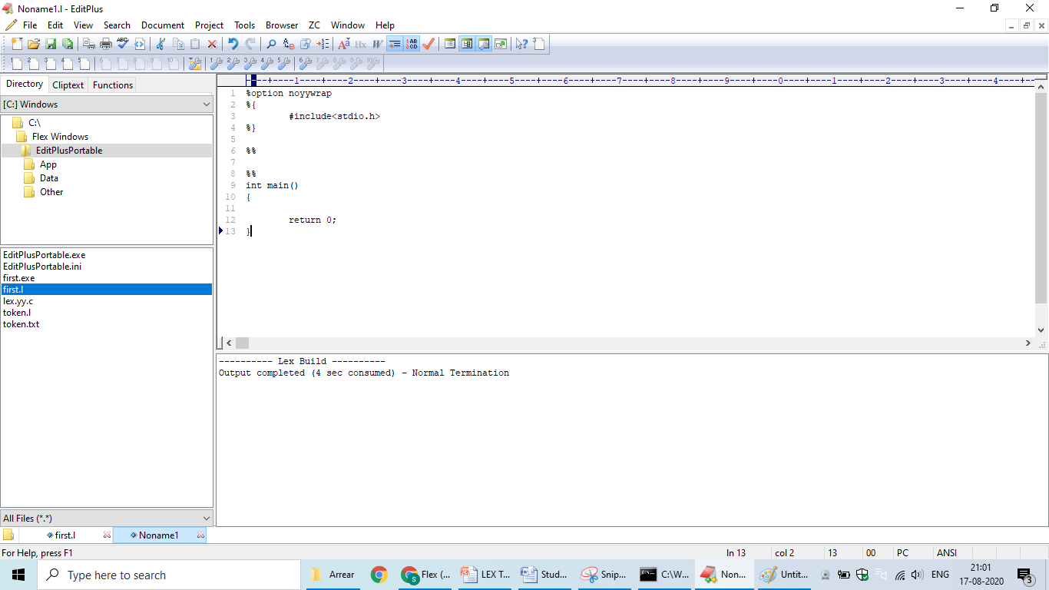

Slide 27
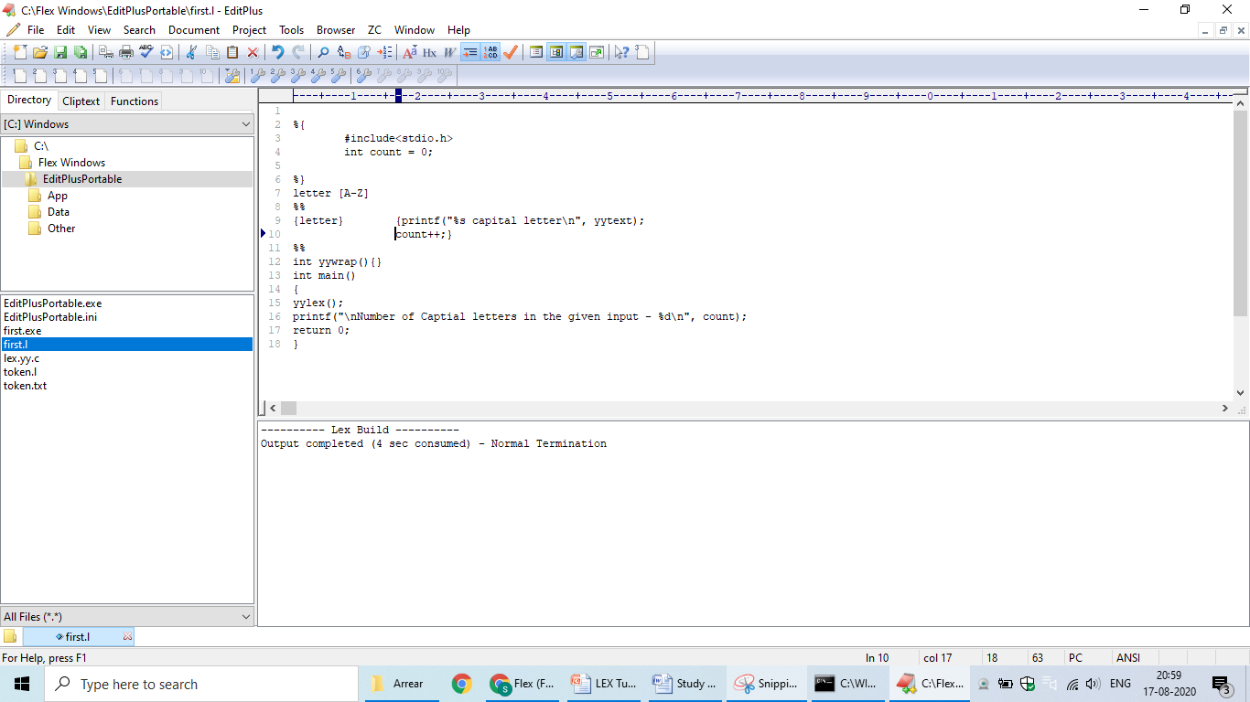

Slide 28
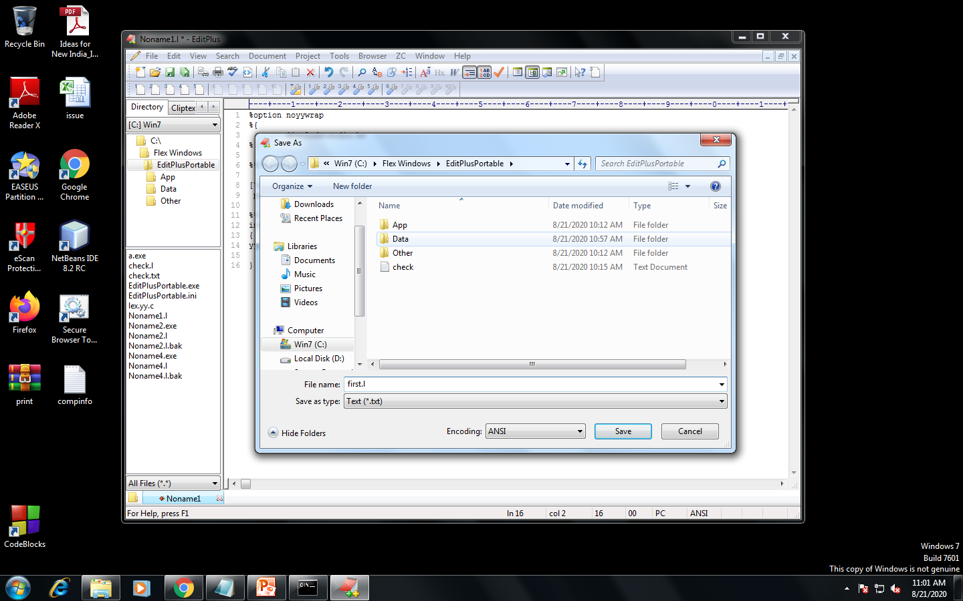

Slide 29
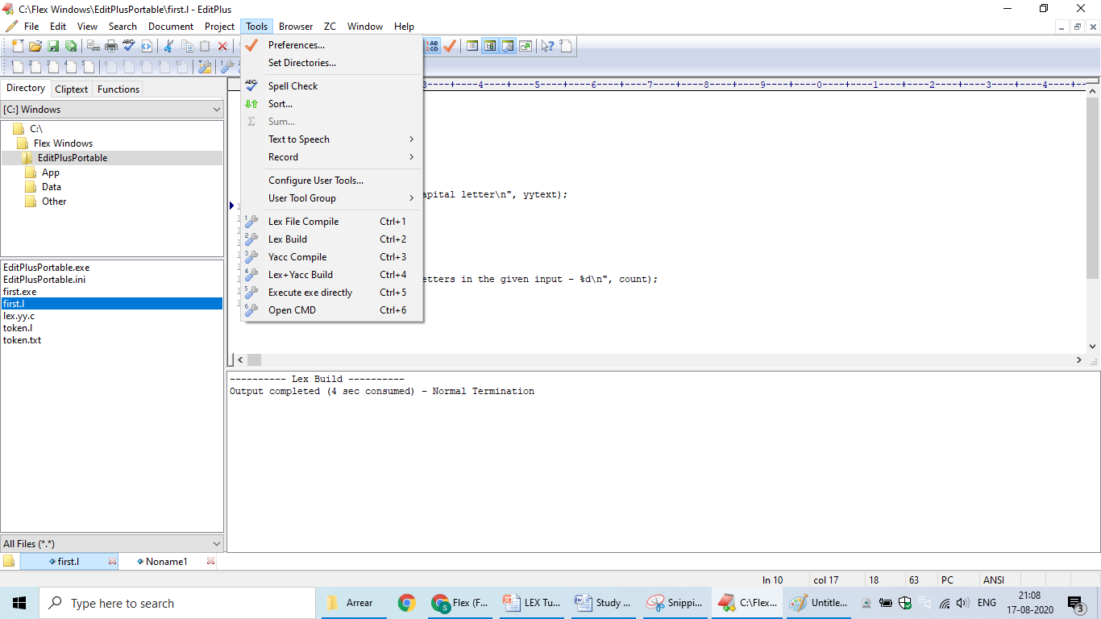

Slide 30
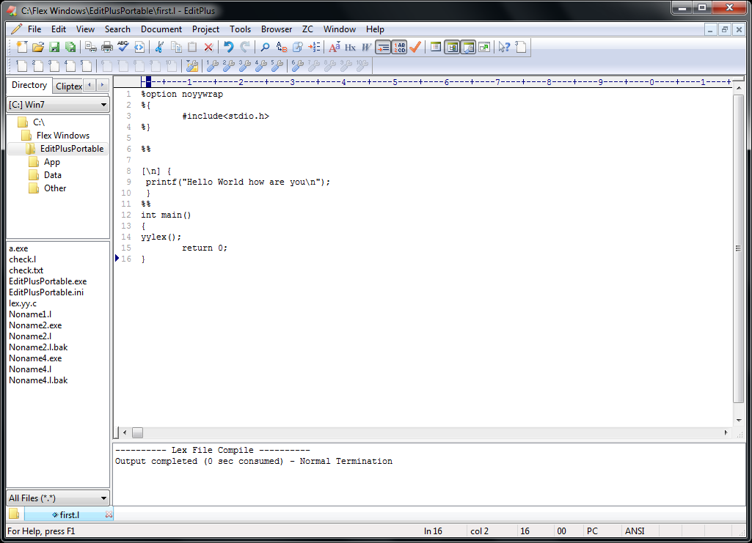

Slide 31
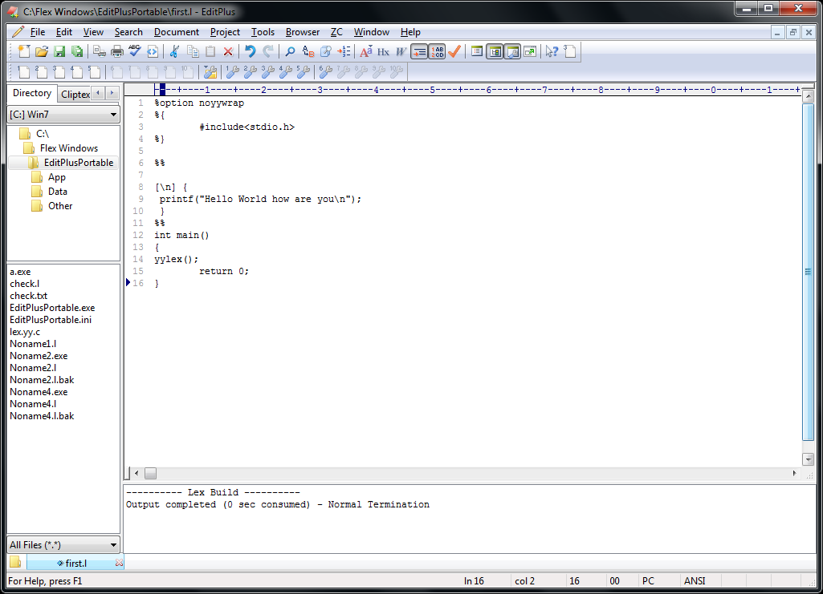

Slide 32
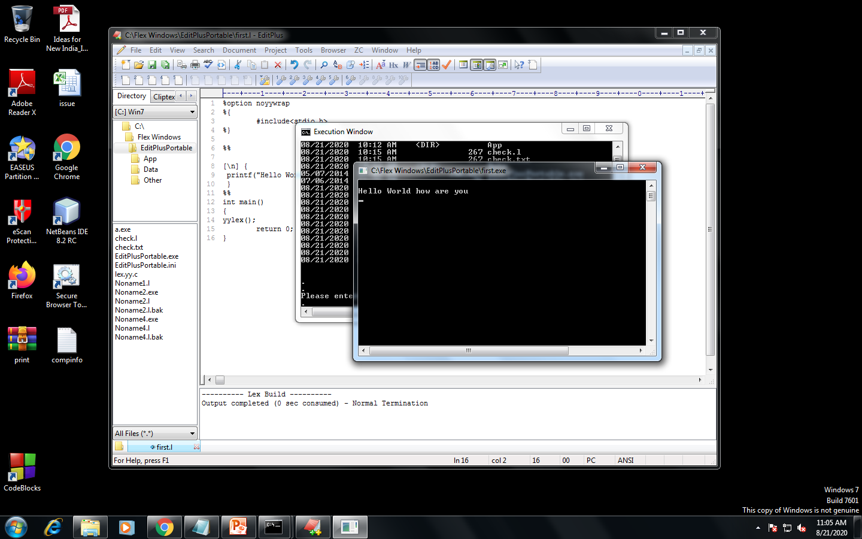

Slide 33
Program to check for odd or even
%option noyywrap
%{
#include<stdio.h>
int i;
%}
%%
[0-9]+ {i=atoi(yytext);
if(i%2==0)
printf("even no");
else
printf("odd no");
};
%%
int main()
{
yylex();
return 0;
}

Slide 34
To count no. of lines, words , tabs and spaces
%option noyywrap
%{
#include<stdio.h>
int lc=0,tc=0,ch=0,sc=0;
%}
%%
[\n] {lc++;}
\t tc++;
[ ] sc++;
. ch++;
%%
int main()
{
yylex();
printf("Line count=%d",lc);
printf("Tab count=%d",tc);
printf("character count=%d",ch);
printf("Space count=%d",sc);
return 0;
}

Slide 35
Lex program to check whether input is digit or not.
%option noyywrap
%{
#include<stdio.h>
digit [0-9]
letter [a-zA-Z]
%}
%%
{digit}+ {printf("%s is digit",yytext);}
{letter}* {printf("%s is identifier",yytext);}
. ;
%%
int main()
{
printf("Enter the Input");
yylex();
printf("end");
return 0;
}

Slide 36
EXERCISE
Write a lex program to identify token using lex tool.

Slide 37
Token Separation
%option noyywrap
%{
#include<stdio.h>
void yyerror(char *);
%}
letter [a-zA-Z]
digit [0-9]
op [-+*]
%%
else|int|float {printf("%s is a keyword",yytext);}
{digit}+ {printf("%s is a number",yytext);}
{letter}({letter}|{digit})* {printf("%s is an identifier",yytext);}
{op} {printf("%s is an operator",yytext);}
. yyerror("error");
%%
void yyerror(char *s)
{
fprintf(stderr,"%s\n",s);
}
int main()
{
yylex();
return 0;
}

Slide 38
Exercise-2
Evaluation of Arithmetic expression using Ambiguous Grammar(Use Lex and Yacc Tool)
E-> E+E | E-E|E*E | E/E| (E) | id

Slide 39
Role of Parser
Lexical Analyzer
token
Parser
Rest of front end
source
parse
intermediate
program
tree
representation
get next token
Symbol Table

Slide 40
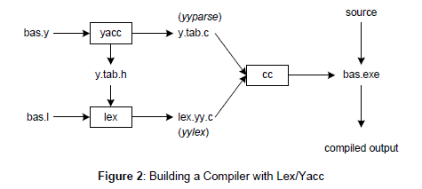

Slide 41
CMD
lex bas.l # create lex.yy.c
yacc –d bas.y # create y.tab.h, y.tab.c
cc lex.yy.c y.tab.c # compile/link

Slide 42
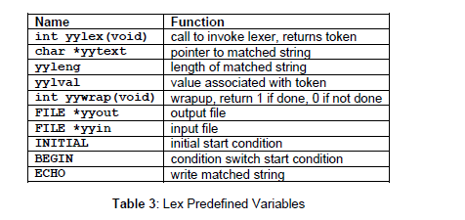

Slide 43
Lex file (file.l)
%option noyywrap
%{
#include<stdio.h>
#include"y.tab.h"
void yyerror(char *s);
extern int yylval;
%}
digit [0-9]
%%
{digit}+ {yylval=atoi(yytext);return NUM;}
[-+*/\n] {return *yytext;}
\( {return *yytext;}
\) {return *yytext;}
. {yyerror("syntax error");}
%%

Slide 44
Yacc file (file.y)
%{
#include<stdio.h>
void yyerror(char*);
extern int yylex(void);
%}
%token NUM
%%
S:
S E '\n' {printf("%d\n",$2);}
|
;
E:
E '+' E {$$=$1+$3;}
|E '-' E {$$=$1-$3;}
|E '*' E {$$=$1*$3;}
|E '/' E {$$=$1/$3;}
|'(' E ')' {$$=$2;}
|NUM {$$=$1;}
%%
void yyerror(char *s)
{
printf("%s",s);
}
int main()
{
yyparse();
return 0;
}

Slide 45
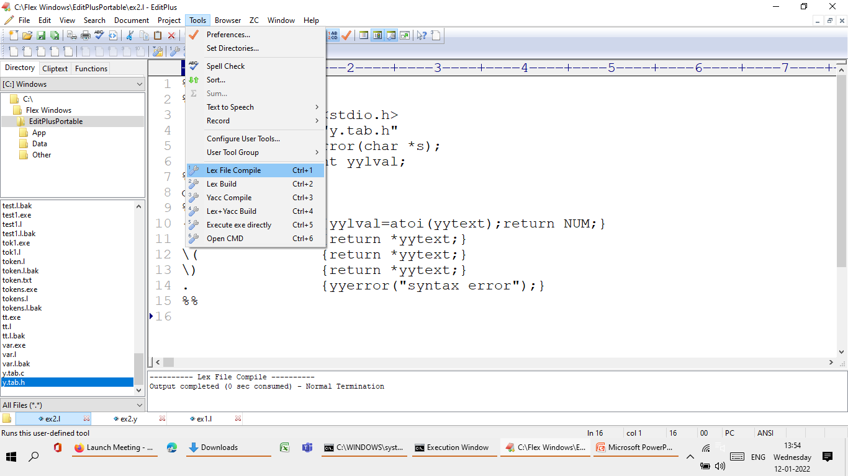

Slide 46
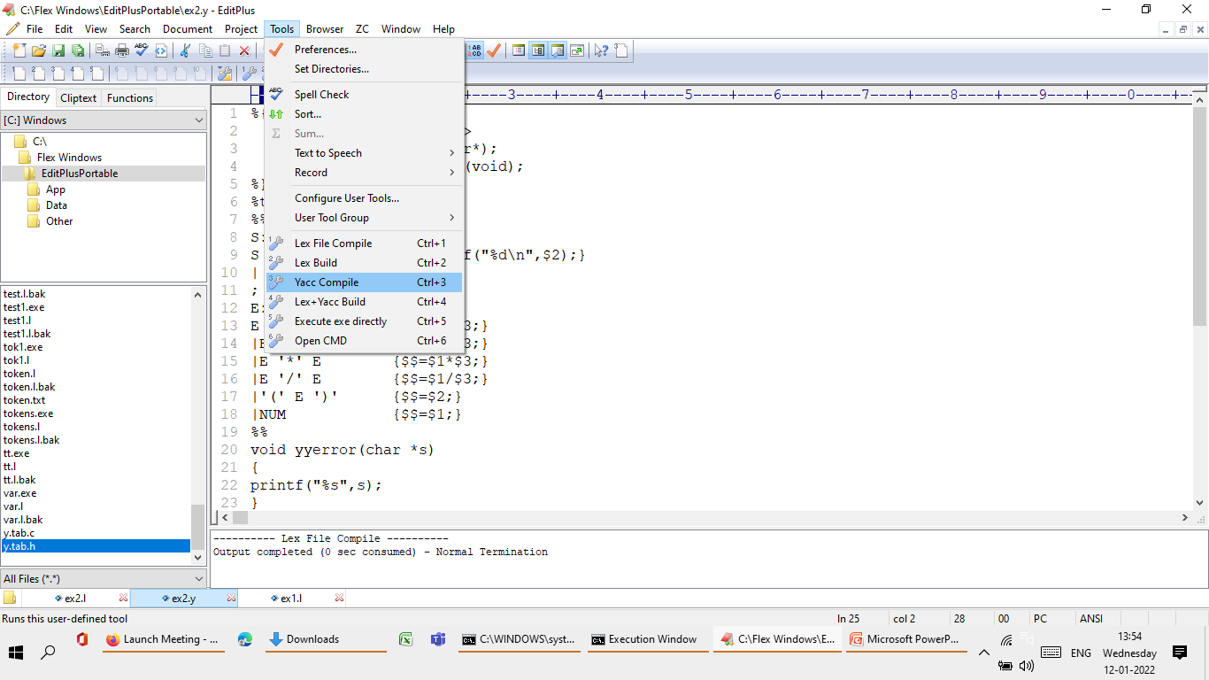

Slide 47
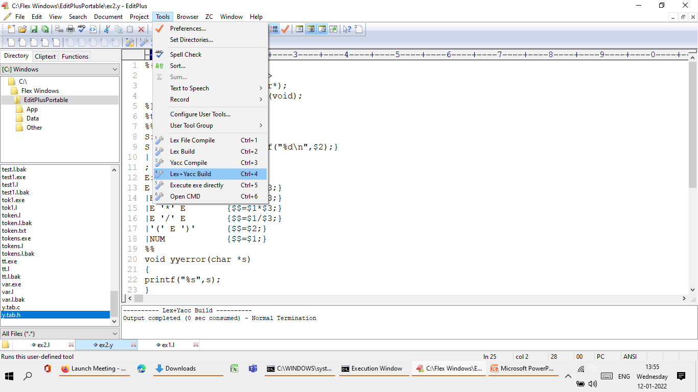

Slide 48
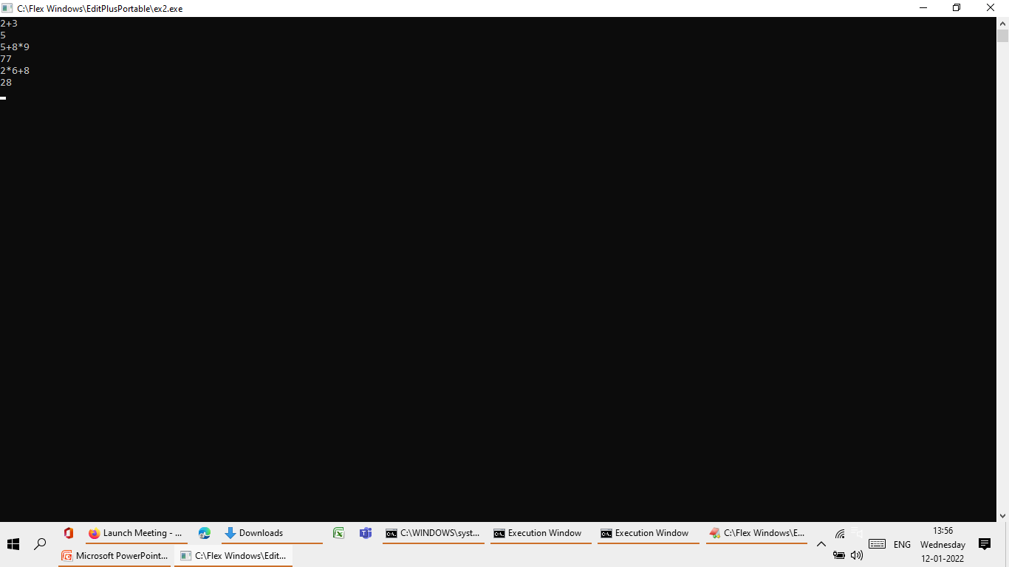

Slide 49
Exercise-3
Evaluation of Arithmetic expression using Unambiguous Grammar(Use Lex and Yacc Tool)
E-> E+T | E-T|T
T->T*F | T/F|F
F-> (E) | id

Slide 50
Exercise-3-Lex File
%option noyywrap
%{
#include<stdio.h>
#include"y.tab.h"
void yyerror(char *s);
extern int yylval;
%}
digit [0-9]
%%
{digit}+ {yylval=atoi(yytext);return NUM;}
[-+*/\n] {return *yytext;}
\( {return *yytext;}
\) {return *yytext;}
. {yyerror("syntax error");}
%%

Slide 51
Exercise-3-Yacc File
%{
#include<stdio.h>
void yyerror(char *);
extern int yylex(void);
%}
%token NUM
%%
S:
S E '\n' {printf("%d \n",$2);}
|
;
E:
E '+' T {$$=$1+$3;}
|E '-' T {$$=$1-$3;}
|T {$$=$1;}
T:
T '*' F {$$=$1*$3;}
|T '/' F {$$=$1/$3;}
|F {$$=$1;}
F:
'(' E ')' {$$=$2;}
|NUM {$$=$1;}
%%
void yyerror(char *s)
{
printf("%s",s);
}
int main()
{
yyparse();
return 0;
}

Slide 52
Exercise-4 Desktop Calculator
Lex Program:
%option noyywrap
%{
#include<stdio.h>
#include"y.tab.h"
void yyerror(char *s);
extern int yylval;
%}
digit [0-9]
%%
{digit}+ {yylval=atoi(yytext);return NUM;}
[a-z] {yylval=toascii(*yytext)-97;return ID;}
[A-Z] {yylval=toascii(*yytext)-65;return ID;}
[-+*/=\n] {return *yytext;}
\( {return *yytext;}
\) {return *yytext;}
. {yyerror("syntax error");}
%%Desktop Calculator

Slide 53
Exercise-4 Desktop Calculator
YACC Program
%{
#include<stdio.h>
void yyerror(char*);
extern int yylex(void);
int val[26];
%}
%token NUM ID
%%
S:
S E '\n' {printf("%d\n",$2);}
| S ID '=' E '\n' {val[$2]=$4;}
|
;
E:
E '+' T {$$=$1+$3;}
|E '-' T {$$=$1-$3;}
|T {$$=$1;}
T:
T '*' F {$$=$1*$3;}
|T '/' F {$$=$1/$3;}
|F {$$=$1;}
F:
'(' E ')' {$$=$2;}
|NUM {$$=$1;}
|ID {$$=val[$1];}
%%
void yyerror(char *s)
{
printf("%s",s);
}
int main()
{
yyparse();
return 0;
}

